Slide 1

NumPy for Numerical Data Analysis
Arrays, vectorization, broadcasting, and high-performance computing — explained with viral cat, dog, & hamster meme mechanics.
NUMERICAL COMPUTING IN PYTHON
SLIDE 1 • INTRODUCTION

Slide 2




1. FOUNDATIONS
What is NumPy & Why It Exists
PURE PYTHON OVERHEAD
Standard lists store boxed objects scattered across RAM with pointer dereferencing, making 1,000,000 loop calculations a slow, confusing ordeal.
THE NUMPY SOLUTION
Pre-compiled C routines operating on contiguous memory buffers that crunch mathematical operations at hardware speed with SIMD instructions.
HARDWARE EFFICIENCY
Direct L1/L2 CPU cache utilization with compact byte representation instead of heavy Python object headers.
FOUNDATIONS • CORE MOTIVATION SLIDE 2

Slide 3



1. FOUNDATIONS
The ndarray: "If It Fits, I Sits"
Python Lists = Cats in Random Boxes: Separate boxes of different sizes scattered across rooms with high pointer overhead.
NumPy ndarray = The Egg Carton: Homogeneous, fixed-type elements seated tightly in a single contiguous memory grid.
FOUNDATIONS • THE NDARRAY OBJECT
SLIDE 3

Slide 4







2. WORKING WITH ARRAYS
Array Creation Mechanisms
1. Initializers
2. Numeric Ranges
3. Random Sampling
Pre-allocate memory blocks with constant initial values.
Generate stepped ranges or evenly spaced mathematical intervals.
Produce seeded distributions for reproducible scientific testing.
WORKING WITH ARRAYS • CREATION
SLIDE 4

Slide 5

2. WORKING WITH ARRAYS
Indexing & Slicing: The Mirror Cat
Basic Slicing (Zero-Copy)
Boolean Masking & Fancy Indexing
Slicing does not clone data; it produces a view sharing original memory. Modifying the view changes the source array directly!
Selecting by condition creates an independent memory copy. Modifying the resulting array leaves the original intact.
WORKING WITH ARRAYS • SLICING & VIEWS
SLIDE 5

Slide 6
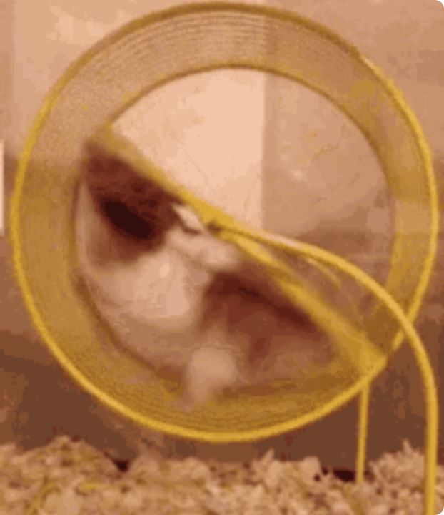
3. COMPUTATION
Vectorization: High-Speed C Execution
MANUAL FOR-LOOP
Walking up to 1,000,000 hamsters one-by-one to spin their wheels. Slow, exhausting, and CPU-intensive with high interpreter overhead.
VECTORIZED EXECUTION
The turbo hamster running wheel! Pre-compiled C machine code spins all 1,000,000 elements simultaneously in hardware registers.
UNIVERSAL FUNCTIONS
Fast ufuncs like , , and execute natively in compiled C without loop overhead.
COMPUTATION • VECTORIZED MATH SLIDE 6

Slide 7

3. COMPUTATION
Broadcasting: The Long Cat Rule
Mismatched Shapes? Adding a single 1D vector (3,) to a (3, 3) matrix automatically stretches the vector across all rows.
Zero Memory Overhead: Shapes are compatible when trailing dimensions are equal or one is 1. NumPy broadcasts virtually without duplicating memory!
COMPUTATION • BROADCASTING RULES
SLIDE 7

Slide 8
4. ANALYSIS TOOLKIT
Statistical & Aggregate Reductions
Analysis Goal | NumPy Function | Axis Parameter | Meme Analogy
Central Tendency | np.mean() / np.median() | axis=0 (down column) | Swatting straight down the scratching post
Spread & Variance | np.std() / np.var() | axis=1 (across row) | Sprinting horizontally along the high shelf
Totals & Accumulation | np.sum() / np.cumsum() | axis=0 | Tracking total treat consumption over time
Boss Extrema | np.min(), np.max(), argmax() | axis=None (all) | Finding the index of the absolute chonkiest pet
ANALYSIS TOOLKIT • DESCRIPTIVE STATISTICS
SLIDE 8

Slide 9
4. ANALYSIS TOOLKIT
Reshaping & Linear Algebra
Reshaping & Axes
np.linalg & Matrix Math
Pets are liquid: they fit into any container shape without changing their mass or element order.
The operator and power PCA, regression, and neural network matrix multipliers.
ANALYSIS TOOLKIT • RESHAPING & LINEAR ALGEBRA
SLIDE 9

Slide 10

4. ANALYSIS TOOLKIT
Handling Missing Data: np.nan
CORRUPTED DATA GAPS
When unexpected gaps hit calculations, standard Python panics like the Staring Hamster on FaceTime. NumPy handles them gracefully with .
MASKING & ROBUST STATS
Filter missing entries with or compute robust statistics with and .
INFINITY DETECTION
Catch divide-by-zero occurrences instantly using without breaking analytical pipelines.
ANALYSIS TOOLKIT • MISSING VALUES SLIDE 10

Slide 11




5. IN PRACTICE
Performance: ~100x Speedup
Benchmark comparison: Summing 1,000,000 64-bit floating point numbers in RAM.
Pure Python For-Loop
Interprets bytecode opcodes for each element with massive memory heap pointer lookups.
NumPy SIMD C-Vectorization
Pre-compiled C routines stream raw primitives straight through CPU AVX vector registers.
Hardware L1/L2 Cache Locality
Contiguous memory buffers eliminate memory fragmentation and CPU cache misses completely.
IN PRACTICE • PERFORMANCE BENCHMARK SLIDE 11

Slide 12


5. IN PRACTICE
NumPy's Place in the Data Stack
Pandas
Matplotlib
Scikit-Learn
PyTorch / TF
Labeled tabular DataFrames built directly on top of NumPy ndarrays.
Visual plots and charts rendered straight from raw array data buffers.
Machine learning estimators ingest and output pure numerical arrays.
Deep learning tensors inherit NumPy's strided array memory model.
IN PRACTICE • THE PYTHON DATA STACK
SLIDE 12

Slide 13




WRAP-UP
The End-to-End Analysis Pipeline
2. Mask Gaps
4. Model Handoff
Filter out missing values with .
Pass tensors directly to ML and visualization tools.
1. Ingest Treats
3. Zoomies Math
Load raw numbers into contiguous .
Execute vectorized transforms & matrix dot products.
WRAP-UP • WORKFLOW PIPELINE
SLIDE 13

Slide 14



THE END
Thank You!
You are now officially a NumPy & Numerical Data Analysis Master. Any questions?
WORKING WITH LIBRARIES
NUMPY FOR NUMERICAL DATA ANALYSIS • SLIDE 14

Slide 15






Image Sources
https://ih1.redbubble.net/image.5202129125.6207/bg,f8f8f8-flat,750x,075,f-pad,750x1000,f8f8f8.jpg
Source: www.redbubble.com
https://i.etsystatic.com/25984045/r/il/ed8ed2/4567079003/il_570xN.4567079003_nvzy.jpg
Source: www.etsy.com
https://media.tenor.com/5CIsastSNeMAAAAM/frustration-me.gif
Source: tenor.com
https://static.boredpanda.com/blog/wp-content/uploads/2020/02/funny-cats-long-tall-fb54-png__700.jpg
Source: www.boredpanda.com
https://preview.redd.it/my-friend-keeps-sending-these-hamsters-as-reaction-images-v0-itomr76z385f1.jpg?width=640&crop=smart&auto=webp&s=ba9429b5633f895a1ea09d5bee34be85551f7640
Source: www.reddit.com
https://external-preview.redd.it/the-speed-of-a-sighthound-is-insane-v0-emtkY21iczZzODRnMfXy5P10NrlYYgE0zQ125gH7Gk_Nfir8ZQCmU_omaxtd.png?width=640&crop=smart&format=pjpg&auto=webp&s=351916d793e48f1570309739b5e3110625d86e1c
Source: www.reddit.com

Slide 16

Image Sources
https://media.tenor.com/F4QdS7YKKv4AAAAM/praying-cat.gif
Source: tenor.com

